Slide 1

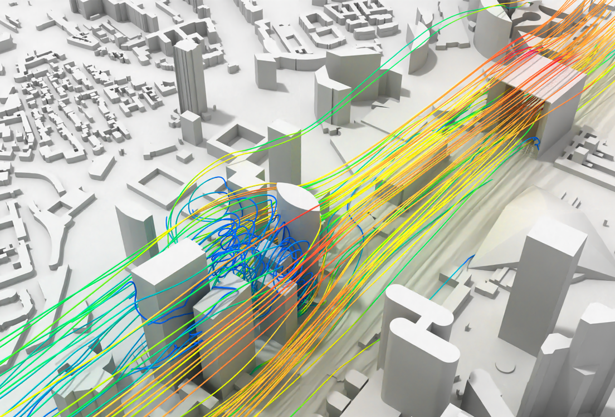
Structural Wind Engineering Final presentation
Students:
Javad Mohebi
Raul San Miguel Penas
Rodrigo Castedo-Hernandez
Technische Universität München 2022

Slide 2

Agenda
Intro…
Fig. 1: Bank of America Plaza [1]
Technische Universität München 2022

Slide 3
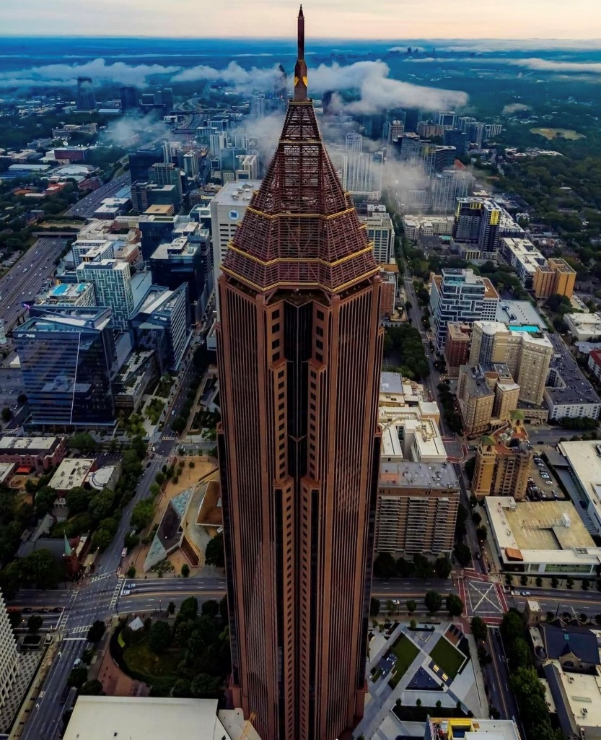
The Structure
Bank of America Plaza:
Height: 250 m
Floors: 55
Width: 55 m
Material: Concrete-Steel Composite
Year completed: 1992
Assumptions:
The cross-section shape is taken as square
The top hollow part is not considered
Fig. 2: Bank of America Plaza [1]
3
Technische Universität München 2022

Slide 4
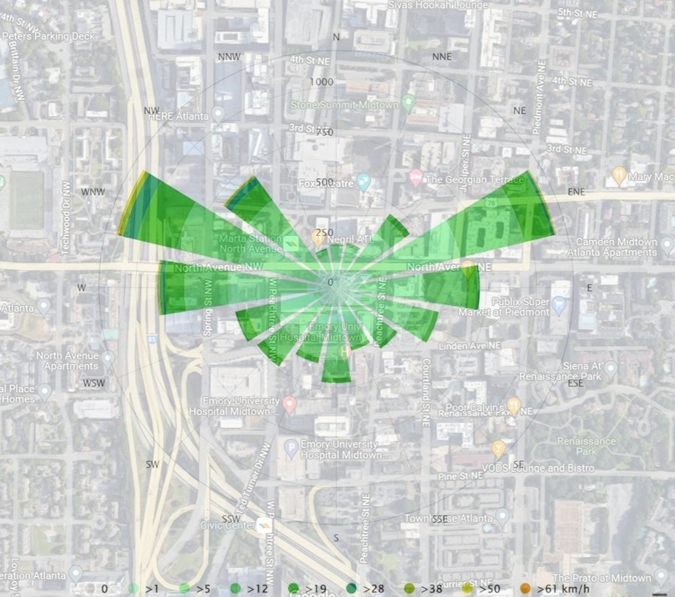
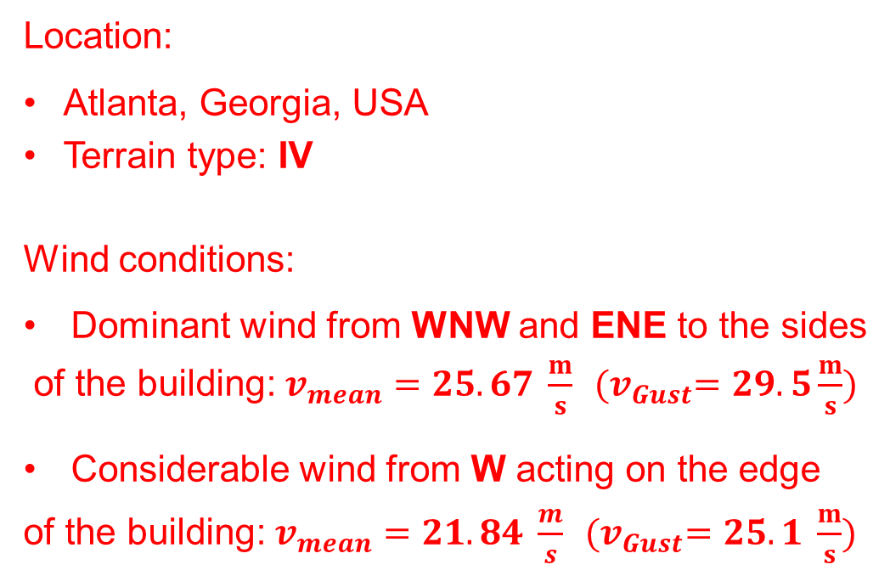
Location and wind conditions
Location:
Atlanta, Georgia, USA
Terrain type: IV
Wind conditions:
Dominant wind from WNW and ENE to the sides
of the building: $v_{mean}=25.67 \frac{m}{s}$ ${(v}_{Gust}=29.5\frac{m}{s})$
Considerable wind from W acting on the edge
of the building: $v_{mean}=21.84 \frac{m}{s}$ ${(v}_{Gust}=25.1 \frac{m}{s})$
Fig. 3: Wind rose according to 30 years data [2]
4
Technische Universität München 2022

Slide 5
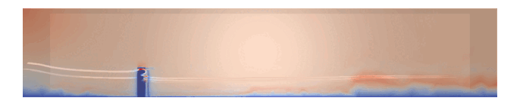
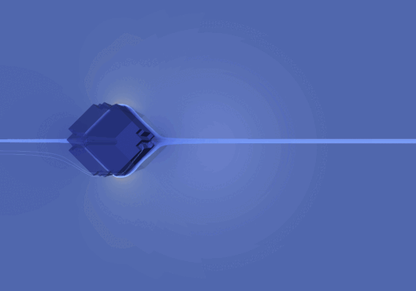
Simulation 1
Flow deformation after hit
Velocity decrease behind the building
Vortex shedding behind the building
Velocity increases at the edges
Fig. 1: Velocity lines in Paraview
Fig. 2: Velocity stream lines from Paraview
5
Technische Universität München 2022

Slide 6
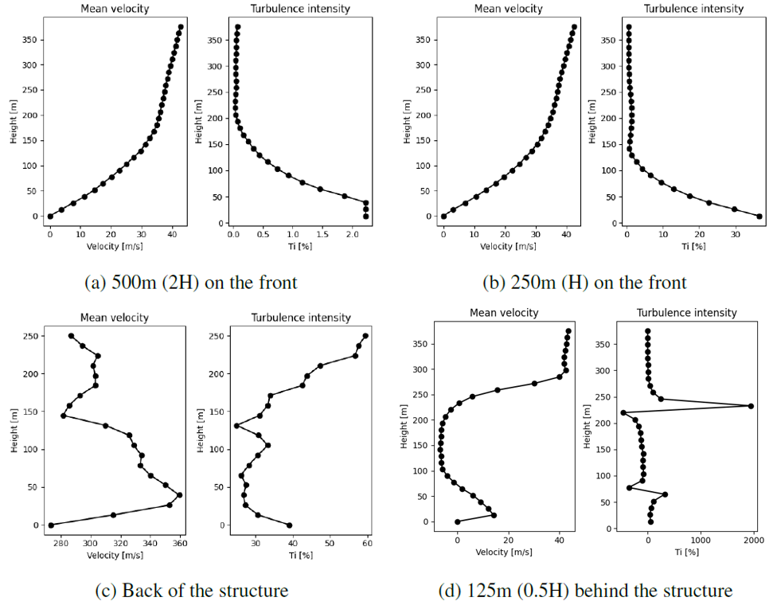
Simulation 1
No influence at H and 2H in front
0 velocity at 0 height due to no-slip BC
Turbulence behind the building
Deformed wind profile behind
Fig. 3: Mean velocities and turbulence intensities
6
Technische Universität München 2022

Slide 7
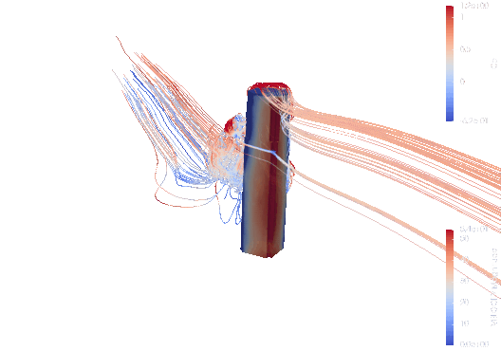
Simulation 1
Increase wind pressure at the edge
Focused on the upper part of the edge
Under pressure region at the back
Gradient pressure decrease on the sides
Fig. 4: Velocity stream lines from Paraview
7
Technische Universität München 2022

Slide 8
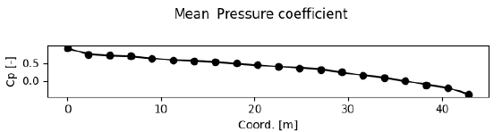
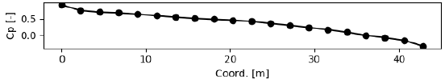
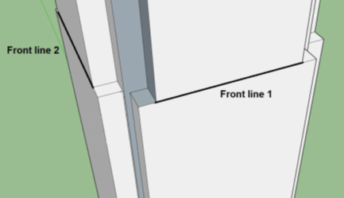
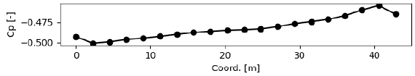
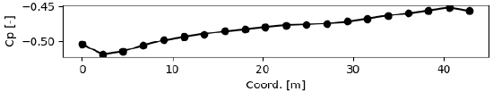
Simulation 1
Line 1
Line 2
Line 3
Line 4
4 assessment lines on the building at the height of 0.6H
Fig. 5: Pressure assessment lines locations.
Fig. 6: Mean pressure coefficients
8
Technische Universität München 2022

Slide 9

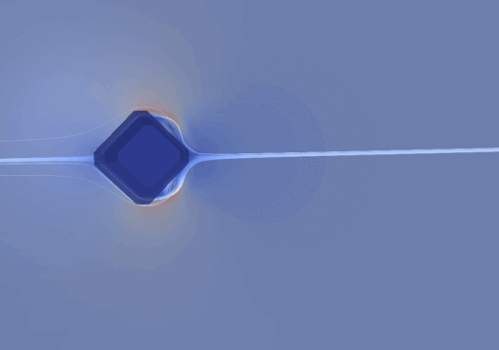
Simulation 2
Simplified geometry
Generally same behavior
Less turbulence at the back
Fig. 7: Velocity lines in Paraview
Fig. 8: Velocity stream lines from Paraview
9
Technische Universität München 2022

Slide 10
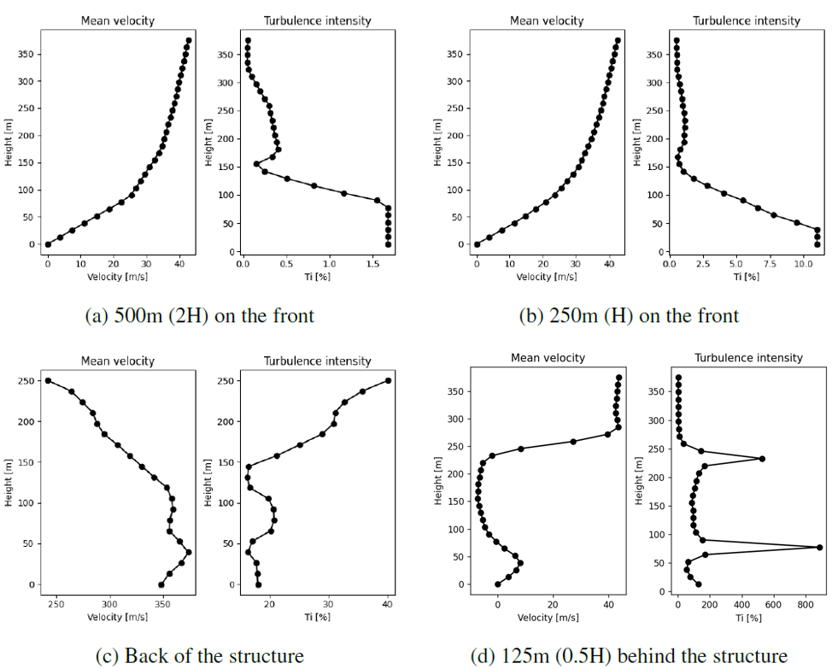
Simulation 2
Simplified geometry
Generally same behavior
Less turbulence at the back
Fig. 9: Mean velocities and turbulence intensities
10
Technische Universität München 2022

Slide 11
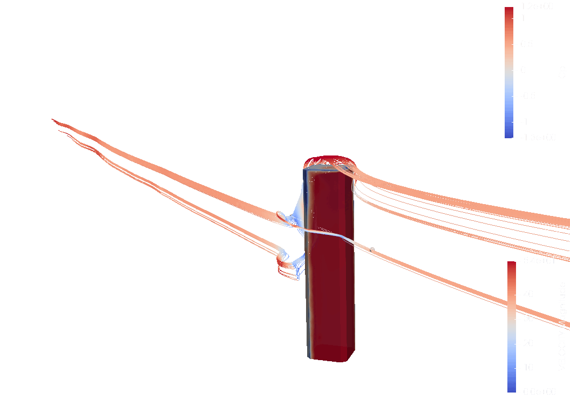
Simulation 2
Generally same behavior
No focus on the upper part of the edge due to simplified geometry
Fig. 10: Velocity stream lines from Paraview
11
Technische Universität München 2022

Slide 12
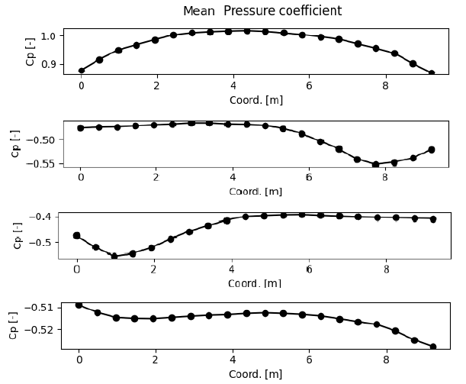
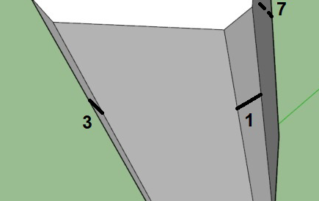
Simulation 2
Line 1
Line 3
Line 7
Line 5
4 assessment lines on the building at the height of 0.6H
Fig. 11: Pressure assessment lines locations.
Fig. 12: Mean pressure coefficients
12
Technische Universität München 2022

Slide 13
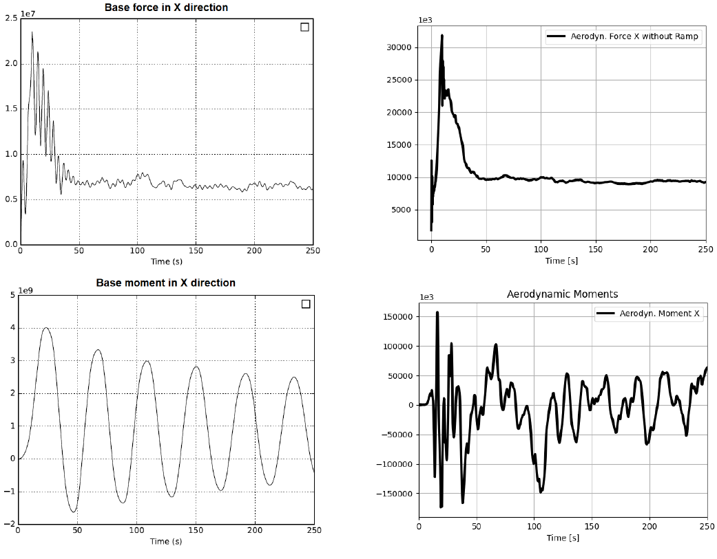
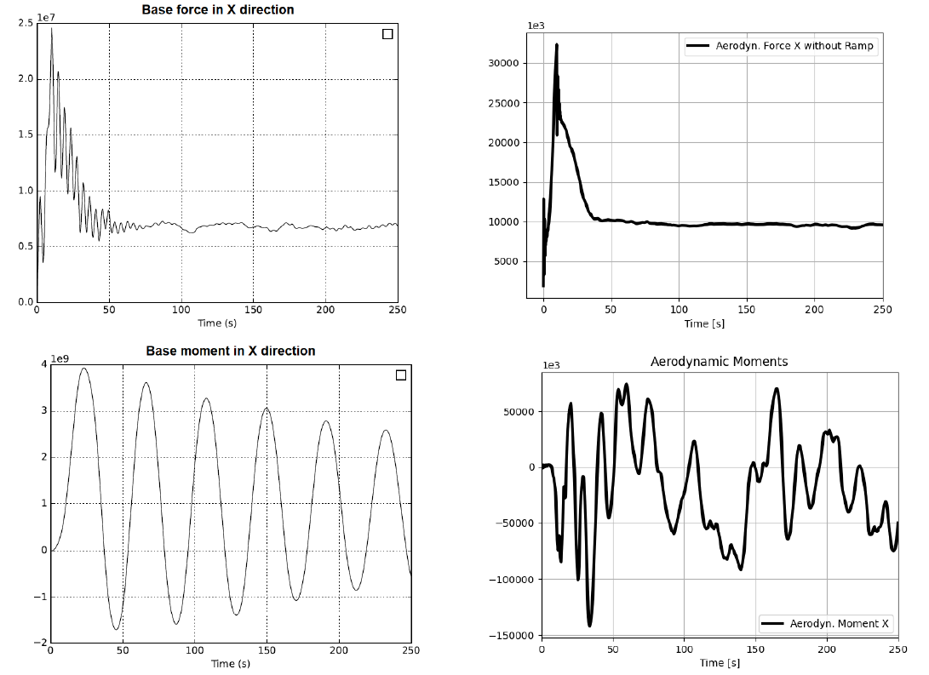
Base forces and moments analysis
Fig. 11: Forces and moments in x-direction simulation 1.
Fig. 12: Forces and moments in x-direction simulation 2.
13
Technische Universität München 2022

Slide 14
Conclusion
Wind behavior around the Bank of America Plaza has been studied using:
Eurocode-based analysis
Two CFD simulations
The effect of the building shape has been studied using:
Wind pressure
Velocity speed and deformation
Base forces and moments
14
Technische Universität München 2022

Slide 15
References
[1] Midtown, “Bank of America Plaza", 2022. [Online] www.midtownatl.com
[2] Meteoblue, “Wind rose“, 1992-2022 [Online] www.meteoblue.com
15
Technische Universität München 2022

